Slide 1
Scheduling Using a Web-Based Shared Calendar
Sarah Hughes
William Paterson University
David & Lorraine Cheng Library
May 30, 2018

Slide 2
Background
New to an Lending Services department
Manage the scheduling of department including full-time, part-time and student workers
Historically, monthly paper-based calendars and weekly emails were the form of communicating schedule
No virtual group calendar

Slide 3
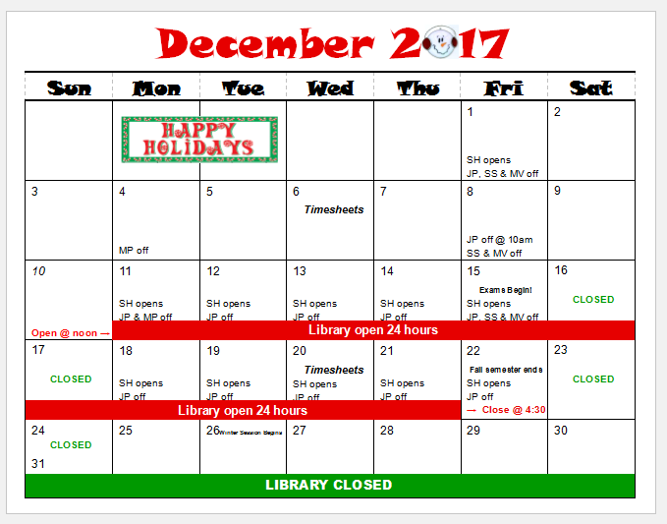
Monthly
Calendar

Slide 4
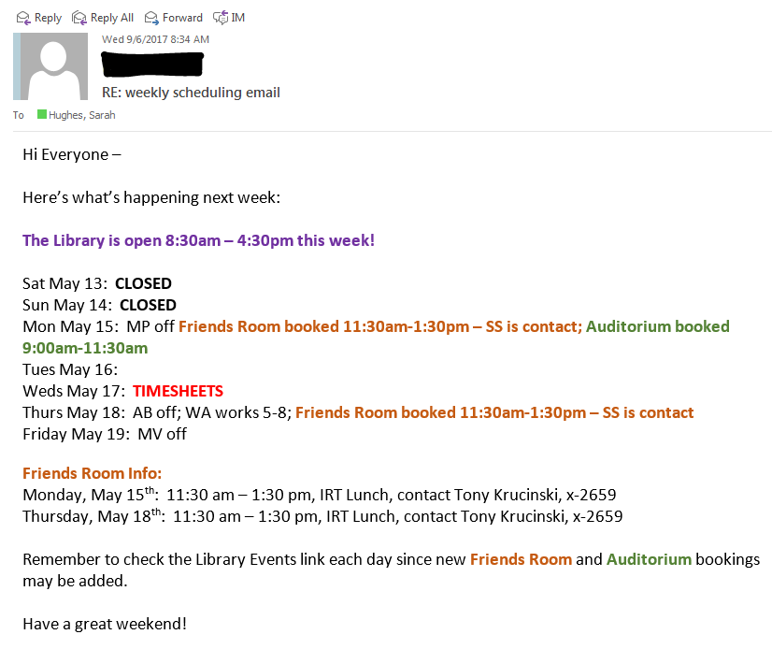
Weekly email to Lending Services staff

Slide 5
Calendar requirements
Assessing what the group needs
Private Administrator being able to make changes
User-friendly Easy for all staff to use
Multiple calendars Tracking multiple type of events and scheduling in the department
Free $

Slide 6
Poll
How do you communicate scheduling within your department?
Paper calendar?
Virtual calendar?
Weekly emails?

Slide 7
Possible solutions
Google Calendar
Outlook Calendar
Teamup Calendar

Slide 8
Teamup benefits
Clean, customizable and simple interface
Organizing your group in one calendar with sub-calendars
Instant updates
Intuitive, easy to use
No account required
Made to share

Slide 9
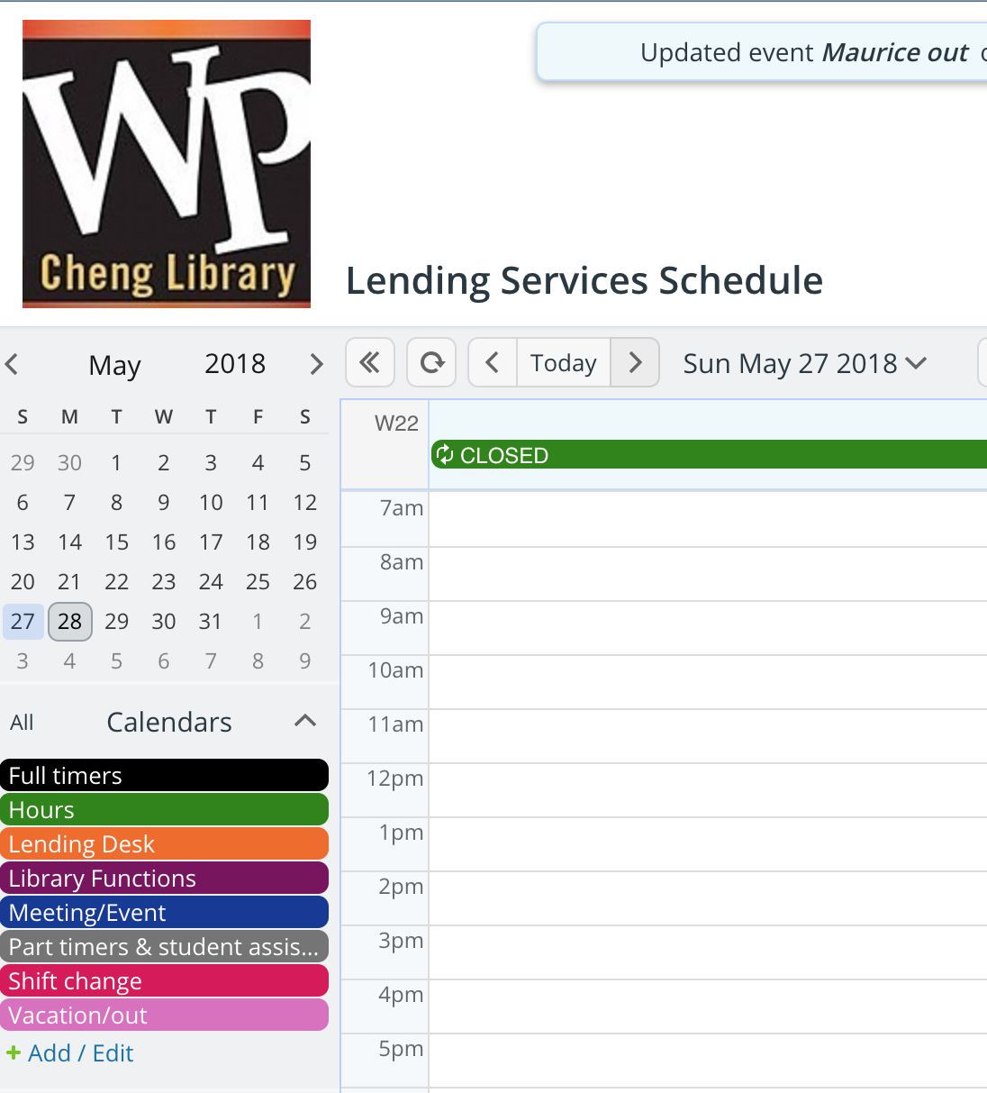
Multiple
calendars
Up to 8 sub-calendars free
Color coded

Slide 10
Access Levels
Administrator
Modifier
Read-only
Read-only without details
Advanced permissions

Slide 11
Various ways to display
Daily
Weekly
Agenda
List
Year

Slide 12
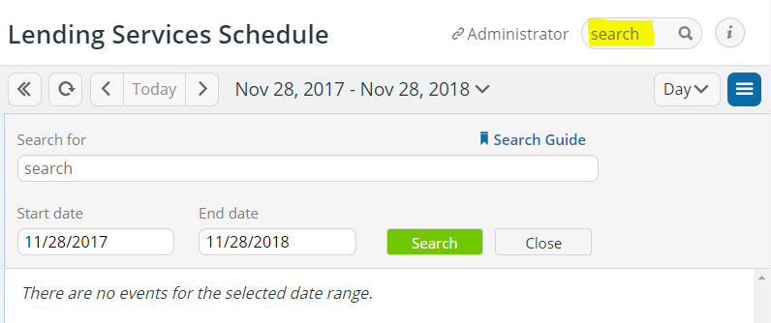
Searchable

Slide 13
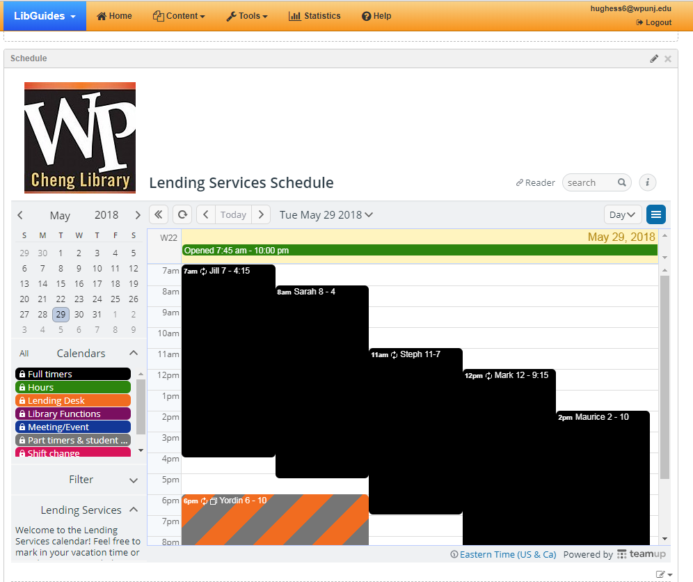
Embed
and share
Use simple iframe code to embed into webpage of choice
Share stable URL as bookmarked on browser of choice

Slide 14
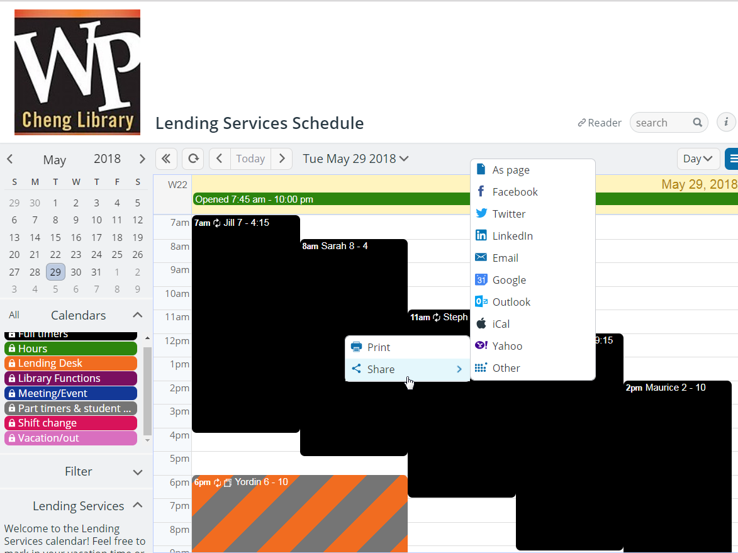
Embed
and share
Configure sharing options

Slide 15
Let’s demo the calendar...

Slide 16
Access on mobile devices
For iPhone/iPad on iOS App Store
For Android devices Google Play Store
Advantage for using app Calendar accessible even when offline. Helpful when internet goes down.

Slide 17
Subscribe to iCalendar Feeds
Can feed calendar data from Teamup to other calendar applications (Google Calendar, Microsoft Outlook or Apple’s iCal)
iCalendar feeds are read-only and provide a periodic automatic synchronization between the source calendar (Teamup) and a third calendar application.

Slide 18
Security & Privacy
Access link
URL random string
Not visible in search engine
No account/login required
Encryption HTTPS
Password
Enable password protection with paid account
Backup
Preventing loss of data
Data replicating continuously on main server to 2 independant remote servers

Slide 19
Results
Creating historical record
Improves scheduling
Ability to ID gaps in coverage
Orient staff to daily schedule
Improves customer service
Team satisfaction!

Slide 20
Questions?
Sarah Hughes
hughess6@wpunj.edu

