Slide 1
Tracking Reserves Not Owned:
Collecting Student Course Reserve Requests at Service Points Using a Web Form
Sarah Hughes
Access Services Librarian
William Paterson University

Slide 2
Background
WPU has an FTE roughly 10,000
Lending Services department holds a small Course Reserves collection
Library has no budget to purchase textbooks
Rely on circulating collection & faculty donations
Hold around 400 items on reserve each semester
Email outreach each semester to faculty to supply class text/books

Slide 3
Initiative
Observed Fall 2017 Lending desk transactions
Students requesting material library does not own
Each transaction was a loss of valuable data to the library
Shift towards a customer service oriented follow-up
Attempt to fill the request by reaching out to instructor
Show the student that the library will help the student
October 2017 semester
Paper form
Spring 2018
Transition to a web form

Slide 4
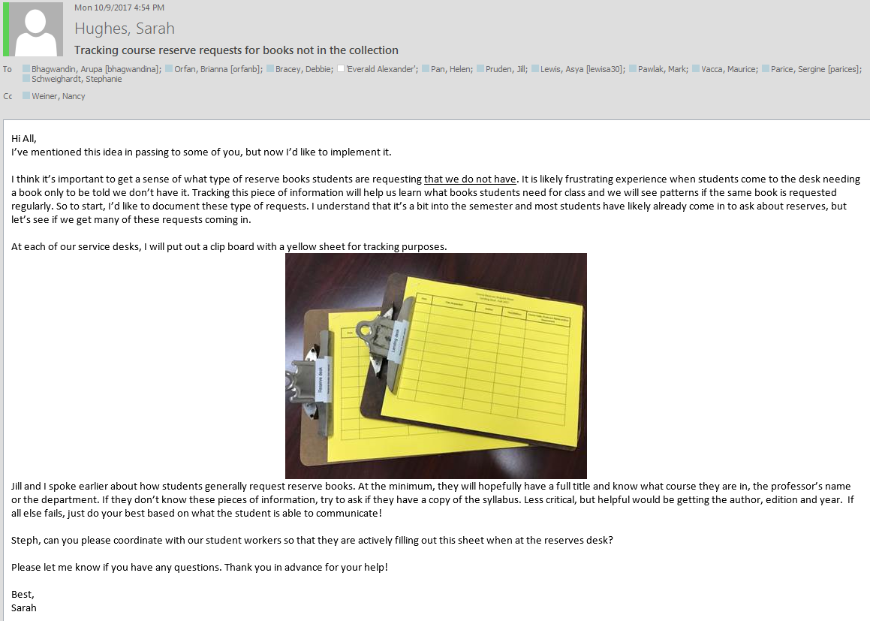
Fall 2017

Slide 5
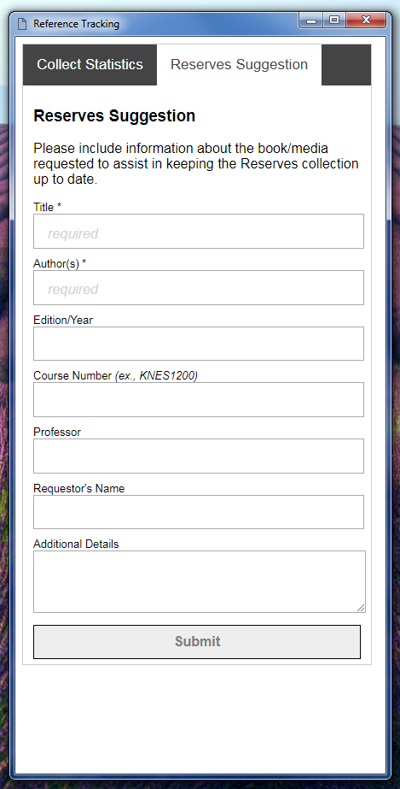
Spring 2018

Slide 6
Spring 2018 - Tracking at three service points
Lending Desk
Lending full time & part time staff
Reserve Desk
Student workers
Reference Desk
Reference Librarians

Slide 7
Workflow
Student approaches desk to ask if they have a book for their class.
Staff, student worker or librarian looks in catalog to see if we have item.
If not available, student is asked if they can collect information on request so library can follow up with their professor.
Staff, student worker or librarian fills out web form on behalf of student.
Workform data sent to Course Reserves email address.
Course Reserves Coordinator forwards request email to faculty member.
Faculty replies (or not).
When book is obtained, Coordinator follows up with student.

Slide 8
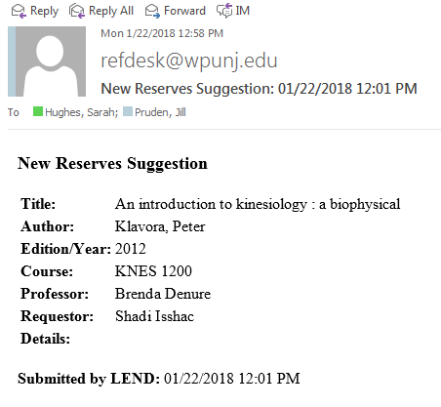

Slide 9
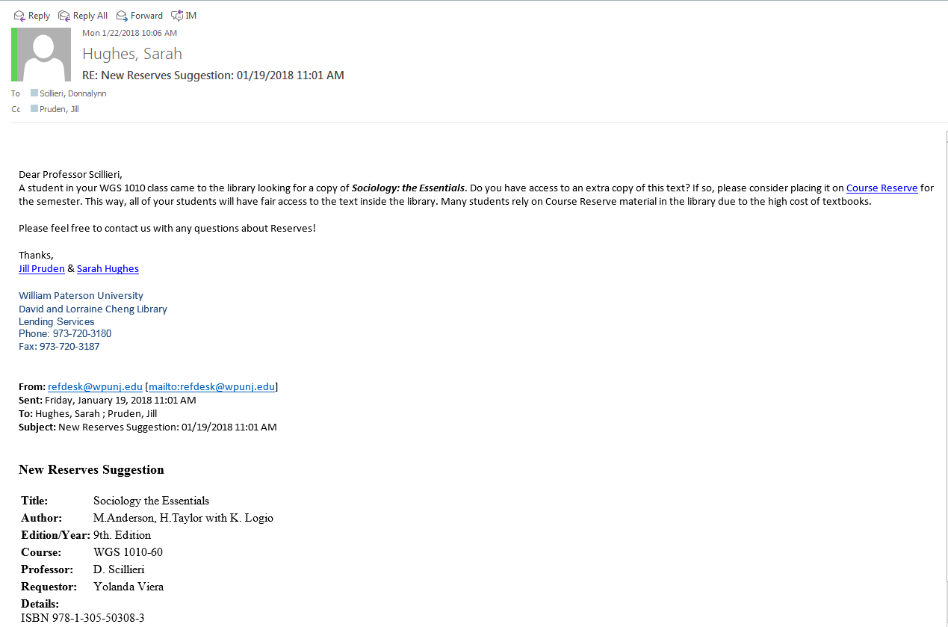

Slide 10
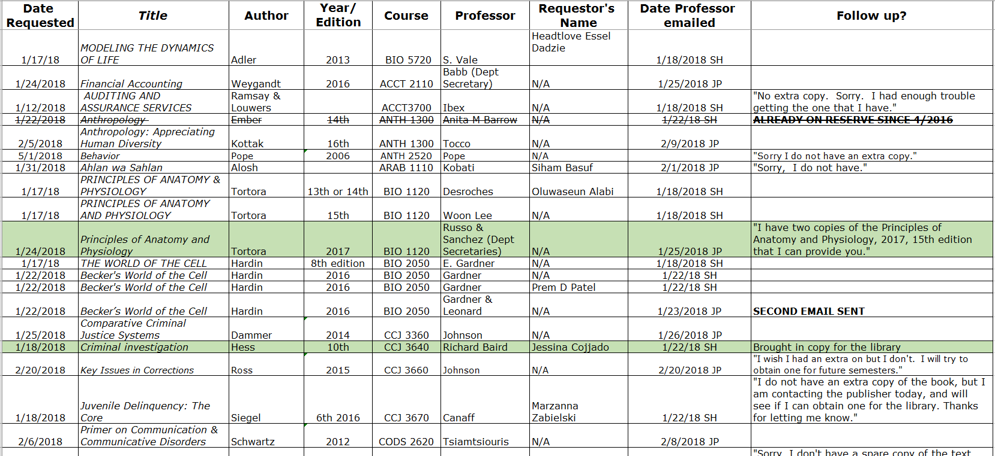

Slide 11
Results for Spring 2018
108 requests total
Tracking app data
Plus cancelled ILL requests
Obtained 20 books from faculty in Spring 2018 collected through web form

Slide 12
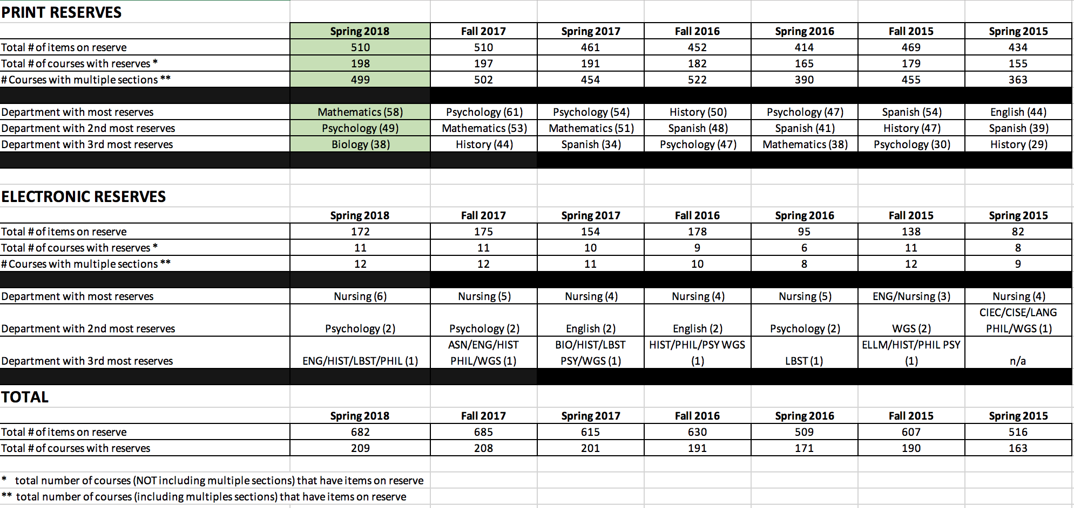
10.6 % increase from Spring 2017 to 2018
5% directly from the Reserves Outreach Form
12.8 % increase Fall 2016 to 2017

Slide 13
Lessons learned
Set realistic expectations
Likely won’t obtain all fields in form
Gently remind those filling out the form to obtain all fields, especially the students name
Busiest period will be first few weeks of the semester
Direct faculty outreach is more personal than a generic mass email
Faculty expressed appreciation for reminder
Upfront work worth it, increased usage and student satisfaction
Discovery of competing departments on campus with mini-reserve collections not affiliated with the library

Slide 14
Questions?
hughess6@wpunj.edu

